Slide 1
Big Data Architecture and Governance
Individual Project | Wayfair
Prathamesh Shrikrishna Verlekar

Slide 2
Wayfair
Industry: Retail
History/Background:
Wayfair is an American e-commerce company that sells furniture and home-goods. Niraj Shah and Steve Conine founded Wayfair in August 2002 and headquartered in Boston, Massachusetts. Its digital platform offers 14 million items from more than 11,000 global suppliers.
In May 2019, Wayfair was added to Fortune 500 list for the first time, coming in at number 446. Wayfair has over 12 million square feet of warehouse space in Europe and North America with a dozen fulfillment centers. Wayfair had the largest market share with 33.4% of online furniture sales; Amazon came in second at 29.7% market share.

Slide 3
Company SWOT Analysis

Slide 4
Company Name: Wayfair
Strengths
Automation of activities
Good Returns on Capital Expenditure
Highly skilled workforce
Successful Market strategies
Strong dealer community
Weaknesses
Poor product demand forecasting
Unsuccessful at integrating firms
Inventory time is high
Ineffective financial planning
Poor organizational structure
Opportunities
Increasing stable free cash flow
Decreasing cost of transportation
Lower inflation rate
Economic uptick in customer spending
Organization’s core competencies can be
a success in similar other product fields
Threats
Intense competition from Amazon
Currency fluctuations
Company can face lawsuits in markets
Rising pay level
New technologies developed by the
competitor or could be a serious treat

Slide 5
Project 1: Efficiently managing Logistics

Slide 6
Issue Name: Efficiently managing logistics
Wayfair’s biggest issue is logistics – getting large items to customer’s home safely
Wayfair is reliant on drop-shippers to ship items to their warehouses, where the items are shipped to customers.
Oversized items must go via less-than-truckload (LTL) or van lines. Which is the most disjointed and archaic industry in the supply chain ecosystem, one that leads to additional cost.
Large item freight leads to damage at most twice the rate as what is seen with smaller packages and if they are moved multiple times via forklift, making the opportunity for damage before delivery.
Hence, compounding the problem is the fact that the capital required to fix it would lead to potential bankruptcy and give other competitors like Amazon an opening to come in and gain upper hand.

Slide 7
Impact Statement
The purpose of this instructional design project research study is to gather live information and tracking details by leveraging big data technologies and this can be done by collecting information from suppliers, warehouses and carriers. It will help the leadership to make decisions that will help efficiently manage and improve the logistics and supplies at Wayfair.
Utilizing this Wayfair can save a lot of money in transportation and provide faster shipping to its customers.

Slide 8
Project Name: Efficiently managing logistics
1. PURPOSE
The purpose of this project is to enable real-time order and tracking information to the warehouse owner by leveraging big data technologies to help efficiently manage and improve logistics at Wayfair.
2. SPONSOR
Chief Operating Officer - Thomas Netzer
3. BACKGROUND
The context of the project is to make use of big data technologies to gather live tracking information. Since, Wayfair has been facing issues delivering large parcels efficiently to its customer due to which the inventory time and the cost for transportation are significantly high. Compounding the problem is the fact that the capital required to fix it would lead to potential bankruptcy. Efficiently managing logistics will be a stand-alone activity to fulfill the business requirement.
4. PROJECT OBJECTIVES
The main objectives of the project are as following:
Decrease the inventory time and transportation cost by leveraging big data technologies
Enable real-time tracking information to the warehouse owners
This will aid the company to enable faster delivery to its customers while also increasing the profitability
5. SCOPE
The major deliverables of the project are to efficiently manage and improve the logistics at Wayfair. Leverage Big data technologies to enable real-time data which can used by the Warehouse owners to make decisions
The project will help deliver large items to customer’s homes safely since large item freight leads to damage at most twice the rate as smaller packages. It will help Wayfair save a lot of money on transportation and improve customer satisfaction.

Slide 9
Project Name: Efficiently managing logistics
6. CONSTRAINTS
The amount of investment that will be needed to buy big data technologies and tools
Company will have to invest in hiring engineers that understand and can work on big data technologies
Warehouse owners will need to understand and learn to use big data tools
7. INTERFACES
Internal interface – www.wayfair.com
External interface – Vendor Management System
8. QUALITY EXPECTATIONS
The quality expectations for this project is meeting the set delivery time with some buffer period for additional requirements
Key requirements will be hiring people with big data expertise for handling and maintaining the project
Ease of use can be done by monitoring some orders from a particular warehouse
Warehouse owners can check if the project has brought an increase in sale and profitability
The customer will have to pay less as delivery charges since there will be no additional transportation cost to the company and a smaller number of products will be damaged
9. OUTLINE BUSINESS CASE
To increase the profitability by decreasing the cost of transportation and providing faster delivery service to the customer

Slide 10
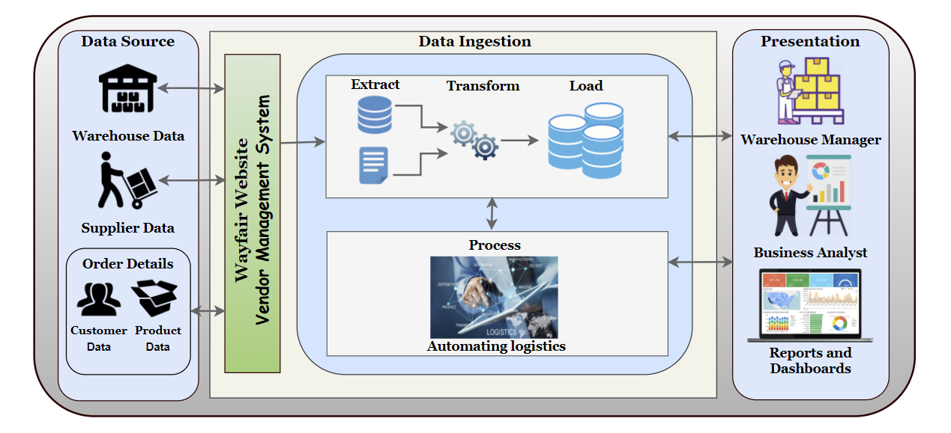
Vision Diagram: Efficiently Managing Logistic

Slide 11
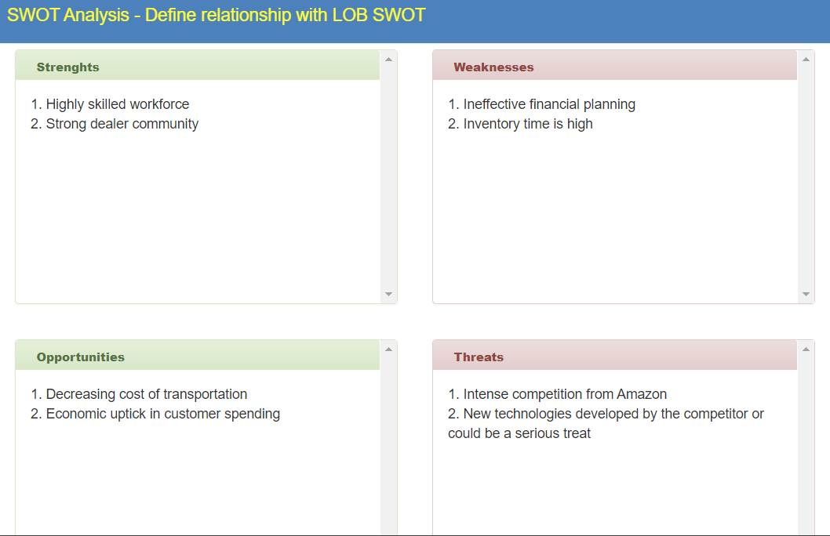
SWOT: Efficiently Managing Logistics

Slide 12
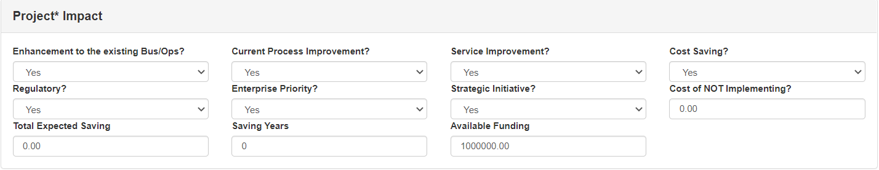
Impact: Efficiently Managing Logistics

Slide 13
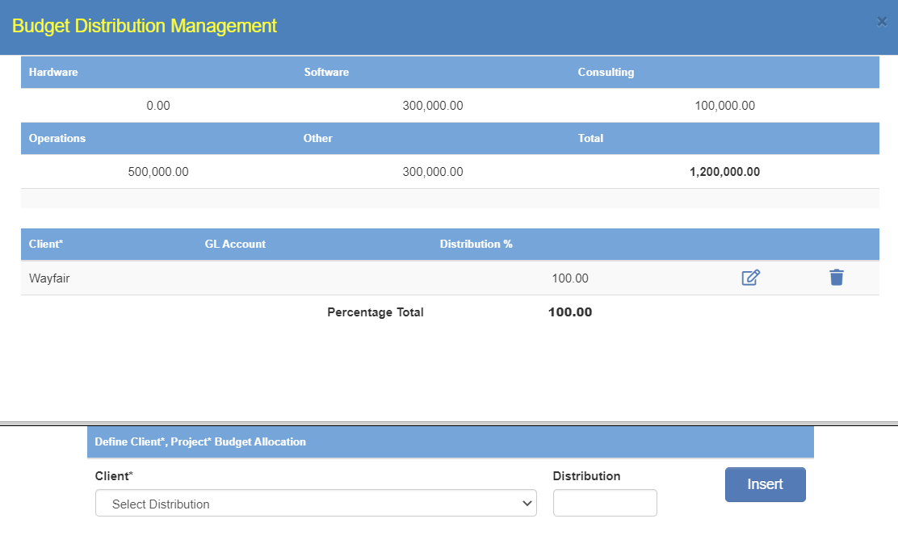
Budget Distribution and Allocation Management: Efficiently Managing Logistics

Slide 14
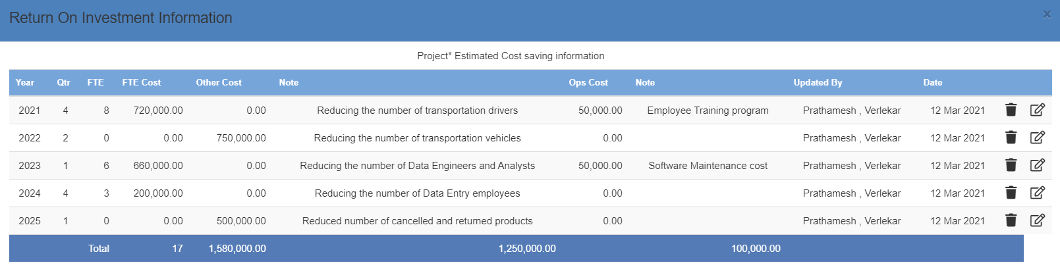
Return on Investment: Efficiently Managing Logistics

Slide 15
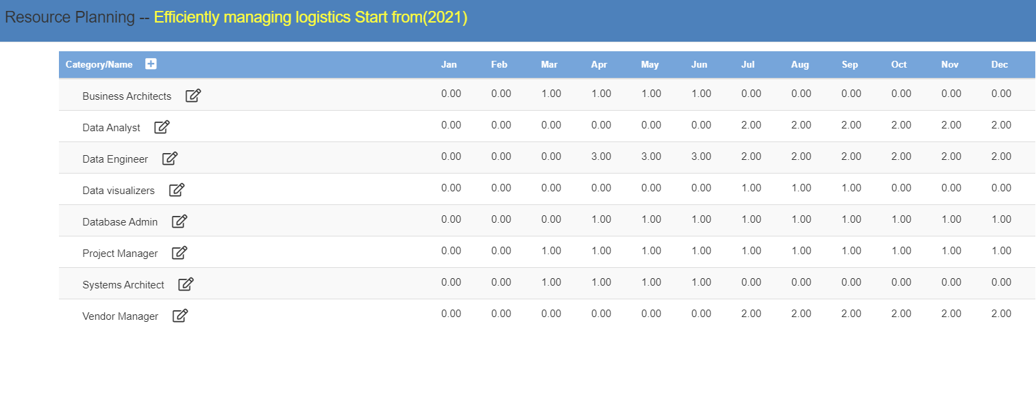
Resource Planning

Slide 16
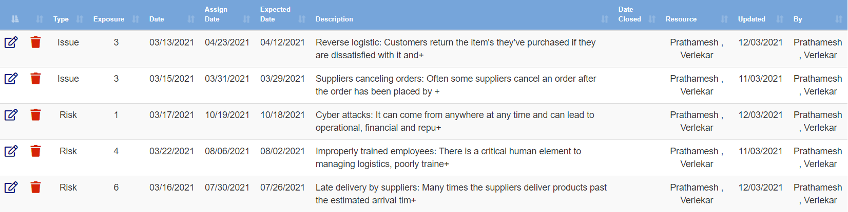
Risk/Issues: Efficiently Managing Logistics

Slide 17
Project 2: Customer Loyalty

Slide 18
Issue Name: Customer Loyalty
Wayfair’s customer retention rate is abysmal
Wayfair is spending egregious amounts on advertising but is losing existing customers faster than they are acquiring new customers.
They are spending about $69 to acquire new customers, but it's only earning $59 back from the customer over the long haul. They are losing money every time they acquire a new customer.
Wayfair is having ugly customer-retention figures i.e., Orders placed by repeat customers are just 55.4% and since it operates on the non-subscription business model, they are losing their old customers to companies like Amazon and Walmart.
Failing to understand customer purchasing patterns that are less predictable and customer churn isn't observable in such business models, Wayfair has been losing a huge amount of money acquiring new customers.
Thus, there is a need for better customer retention policies and ways to improve customer loyalty by understanding the customer needs and patterns effectively.

Slide 19
Impact Statement
The purpose of this instructional design project research study is to understand the customer purchasing patterns and customer churn by leveraging big data technologies to help the Leadership make decisions considering how it will impact the growth and profit of the company.
Additionally, the company will require spending less money in acquiring new customers if they start earning profits from their old and loyal customers.

Slide 20
Project Name: Customer Loyalty
1. PURPOSE
The purpose of this project is to increase the customer retention rate by improving the customer experience. The main aim will be to make use of big data technologies and ML models to provide the customers with personalized services and better rates for their orders
2. SPONSOR
Chief Financial Officer – Michael Fleisher
3. BACKGROUND
The context here is to increase the repeat customer rate, purchase frequency, and average order value by understanding the customer behavior and purchasing patterns. Wayfair’s customer retention rate is abysmal, and they have been losing a huge amount of money acquiring new customers. Improving customer loyalty will be a part of the larger business program
4. PROJECT OBJECTIVES
The main objectives of the project are as following:
The project will try to retain the existing customers by understanding purchasing patterns and providing personalized services
Improve the customer satisfaction and purchase frequency by suggesting only the products which the customer will buy
5. SCOPE
The deliverables of the project is to improve the customer loyalty by understanding customers purchasing pattern, engaging them into royalty programs and improving customer satisfaction.
The project will help the company save egregious amounts on advertising to acquire new customers by retaining old customers

Slide 21
Project Name: Customer Loyalty
6. CONSTRAINTS
Cost constraint can be estimating the costs for using and maintaining big data tools and technologies
Hire experienced ML and Data Engineers that can understand and work on the gathered customer information
Another important constraint can be the restriction of regularity requirements and privacy concerns of the customer data
7. INTERFACES
Internal interface – www.wayfair.com
External interface - www.jossandmain.com, www.allmodern.com
8. QUALITY EXPECTATIONS
The quality expectations for this project are to provide the application on time and proper maintenance
Employing engineers with technical expertise those who can handle situations when the requirement changes and continue maintaining the quality expectations
Customer service team can check if the project has increased customer retention rate by monitoring a group of customers
Improving customer loyalty will aid in giving personalized services to the customers thereby improving the purchasing frequency and average order value which will increase the company’s profit
9. OUTLINE BUSINESS CASE
To increase the customer retention rate and avoid spending a large sum of money acquiring new customers

Slide 22
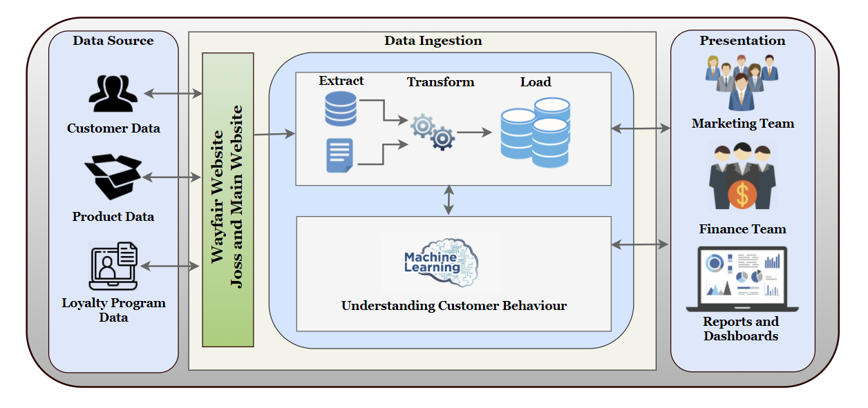
Vision Diagram: Customer Loyalty

Slide 23
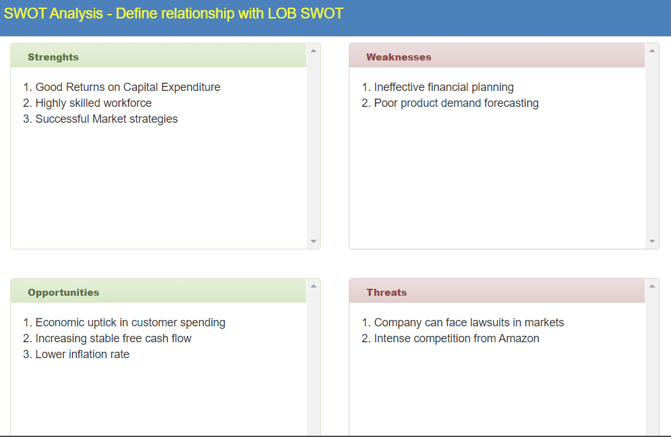
SWOT: Customer Loyalty

Slide 24

Impact: Customer Loyalty

Slide 25
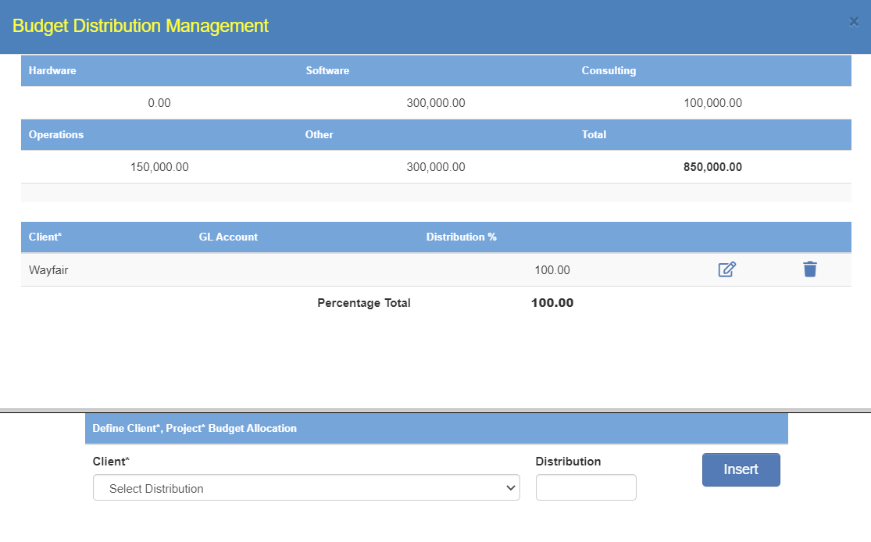
Budget Distribution and Allocation Management: Customer Loyalty

Slide 26
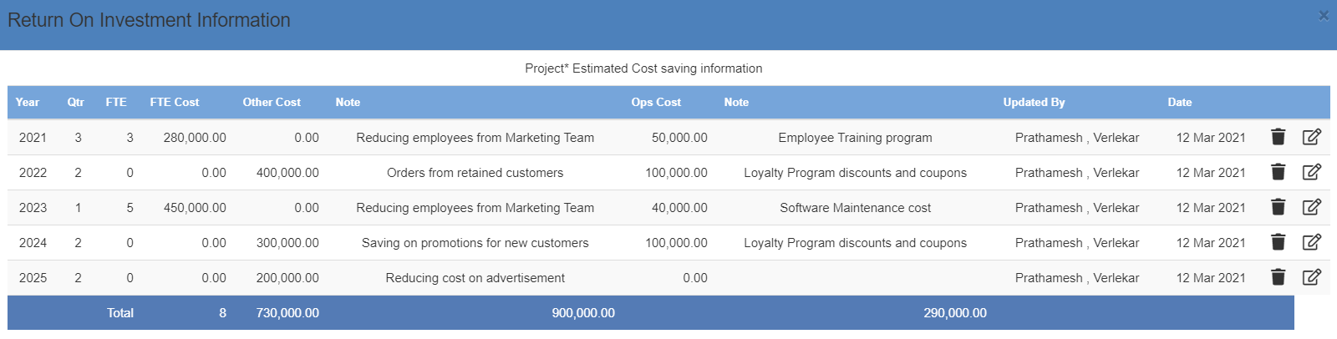
Return on Investment: Customer Loyalty

Slide 27
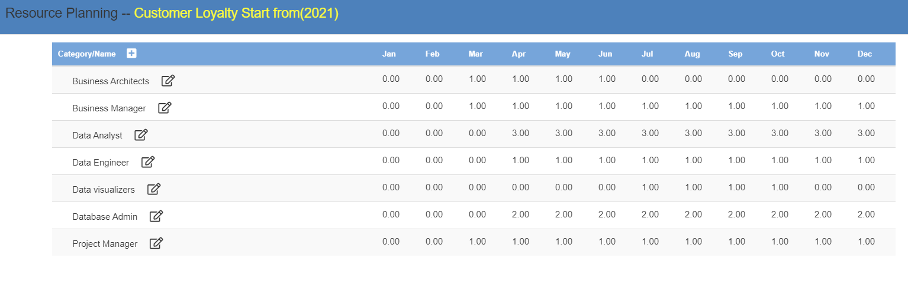
Resource Planning

Slide 28
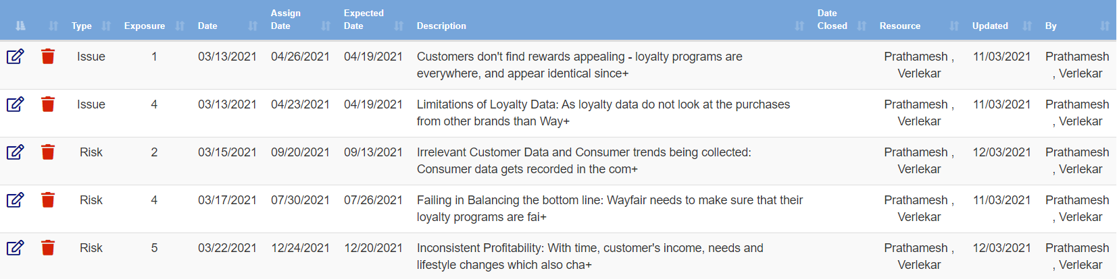
Risk/Issues: Customer Loyalty

Slide 29
Project Selection

Slide 30
Will be choosing Efficiently Managing Logistics project over Customer Loyalty project because of the following reasons
Business Logic
The company’s primary goal is to build one of the largest online selections of furniture - they completely rely on dropship shippers for their revenue.
Wayfair’s 70% of revenue is generated from its suppliers by cutting on additional delivery cost to the customer and ensuring fast and agile delivery.
This project will help Wayfair’s suppliers ship directly to the customers through the model of Drop Shipping, essentially cutting delivery costs and improving delivery speed significantly which will support their business model.
For Customer Loyalty, there will huge amount of investment needed in the beginning for providing customers with discounts and rewards. Also, we will need lot of historical data to get good results and provide proper recommendations to the customer.

Slide 31
Analytics
Efficiently managing logistics would increase the profit of the company by 25-30% and increase customer satisfaction rate.
For efficiently managing logistics it would be easier to acquire data since it falls under transactional data and will be available of real time basis.
For Customer Loyalty, collecting relevant data would be a difficult task since it will require professional and behavioral understanding of data. Customer Loyalty project will require lot of historical data to be collected for every customer before recommending products to them.
For Customer Loyalty, there will huge amount of investment needed in the beginning without any noticeable profit.
Strategic Analysis
Efficiently managing logistics would also improve customer satisfaction since the customers will receive their products with faster delivery.
This will also help increase in customer retention rate and improvement in customer loyalty and would build a better foundation for Customer Loyalty Project.

Slide 32
Impact Score

Slide 33
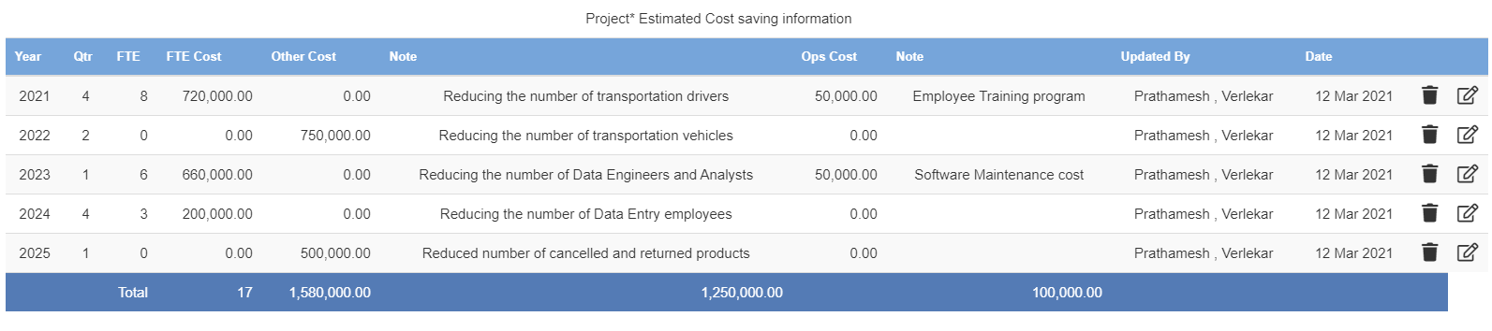
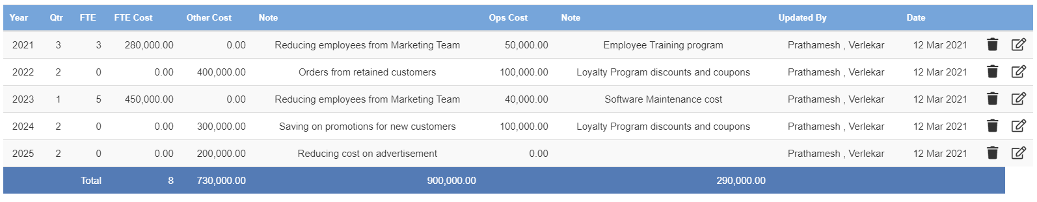
Estimated Return on Investment Comparison shows that ROI for Efficiently Managing Logistic would be more compared to Customer Loyalty Project
ROI for Efficiently Managing Logistics
ROI for Customer Loyalty

Slide 34
FUNCTIONAL REQUIREMENTS

Slide 35
Functional Requirements
BUSINESS REQUIREMENTS
The primary goal is to automate and efficiently manage the logistic at Wayfair by leveraging big data technologies along with Machine Learning and AI. It should help the business in demand forecasting, preventing flaws like understocking and overstocking, deciding the best possible route and mode of transportation and providing a better and faster delivery service to its customers
Various other aspects like Multi-currency and Exchange rates, providing the ability to define any higher-level constraint anywhere in the process, Transfer pricing and taxes. These are the requirements which we need to test and consider to see how efficiently the logistic have been managed
The project needs to have well defined and described Business rules for In Scope and Out of Scope items, in order to make it easier for a Businessperson understand the process and the terms related to it
Maintaining Business Metadata related to the project, this metadata can be from different teams and domains

Slide 36
Functional Requirements
Managing the external interfaces – For this project, the external interfaces would be the Vendor Management System which the company uses. These systems need to be integrated properly in the architecture to avoid any miscommunication between the company and its suppliers
Administration functions – Project administrators will be needed to handle the administrative functions for the project. They will be responsible for scheduling regular meetings and recording decisions i.e., assigned tasks and next steps, creating and updating the workflows, conduct risk analysis, track expenses and predict future costs and monitor project progress
Along with managing the daily administrative functions, they will also be managing project documentation and contracts, raising issues and implementing changes to the planned process based on the requirements
Reporting Requirements – In order to have the best analytical solution, it is necessary to know the requirements from the Business Owners who will be using the result for making decisions
Example the Metrics which should be displayed in the reports, information which is necessary in the report, when the report should be refreshed or updated. Understanding these functional requirements are very important when so many entities and domains are involved

Slide 37
NON-FUNCTIONAL REQUIREMENTS

Slide 38
Non-Functional Requirements
Reliability – The system should be built in a way that the data is available on demand and when required for visualization. All the reports should display the same numbers, and the data on the dashboard and reports should help the managers and leadership take decisions
Scalability – The system should be able to scale up as well as scale out i.e. It should be able to scale vertically as well as horizontally. We should be able to increase the hardware capacity of the machine by adding more RAM or CPU to our system to make it more robust and powerful
Along with this, based on requirements we should be able to add more machines, add more nodes to existing cluster without stopping the running system
Capacity - This project would generate huge volume of new data every minute, so the storage pipeline needs to be created in order to implement this project should be designed in such a way that it can handle huge volume of data. It should be scalable to extend and increase the capacity in future to accommodate the new volume of data generated every minute
Availability – The data to the end consumer should be accessible and information should be continuous. Information with low availability concerns should be considered supplementary rather than necessary
Recoverability – The data needs to be backed up at multiple points, so that if there is any failure at any stage the data could be recovered and there would not be any loss of data and the system could be started from the last backup

Slide 39
Non-Functional Requirements
Maintainability and Serviceability – The system should be easily maintained and repaired with great speed and minimal time. We should be able to diagnose the system whenever problem arises or the system crashes. Early detection of faults would decrease or avoid system downtime. Example:- The system should automatically call a service without human intervention when the system experiences a system fault
Security – The information should be secure at every stage of the process and should be so secure that there is no threat to the data stored in these systems. At every stage of the system, the data should be accessed by the authorized users to prevent any data theft.
Usability – The user interface of the system should be easy to understand and use. The result and output (dashboard, reports, notifications, etc.) should be useful to the managers and leaderships to make decisions.
Performance –The performance of data collection, processing and integration should be robust and should be able to grab the high volume of data coming at enormous velocity. The response time should be negligible, and it should have able to transfer huge amount of data from one network to another.
The company should be able to utilize the analytics to find new insights on increasing the profitability and how they serve their customers.

Slide 40
OVERALL STRATEGY

Slide 41
Overall Strategy
The overall strategy of the project is to create a big data pipeline for efficiently managing logistics, all the data that will be collected, will be stored in a common database with a common format, to run Machine Learning models over it. This will help to perform data analysis simultaneously considering the dependency of the data
All the order, customer and supplier information will be dumped into a Hadoop distributed file system using Apache Kafka from there it will be processed and computed using Apache Spark
We will then be running Machine Learning Models using TensorFlow library to predict and analyze the best possible routes, ideal number of packages in a container and other important aspects which can increase the profit of the company
If the accuracy and predictions are not accurate or as expected, we will re-run the model to improve the accuracy and then store the results into the database for making decisions based on it
For use cases, where we do not need much of the computation and processing, but the data needs to be available on real time basis we will directly stream it into Apache Flink through Kafka and use for sending real time notification and information to the customer and suppliers

Slide 42
Overall Strategy
All this data will be aggregated into MongoDB database. A unified pipeline will help in storing the data in same format across all different departments, the data will be cleaned and processed before storing the data
The MongoDB database will be connected to Tableau using MongoDB connector for BI and we will have live connection, so we always have refreshed and live data
Security will be maintained at every level and only authorized people will be given access to view the data. Even the reports will have restrictions invoked to avoid displaying information to unauthorized user
Finally, the end users will have a dashboard which they can use for analysis and making important decisions that can increase the profit of the company

Slide 43
Technical Vision diagram

Slide 44
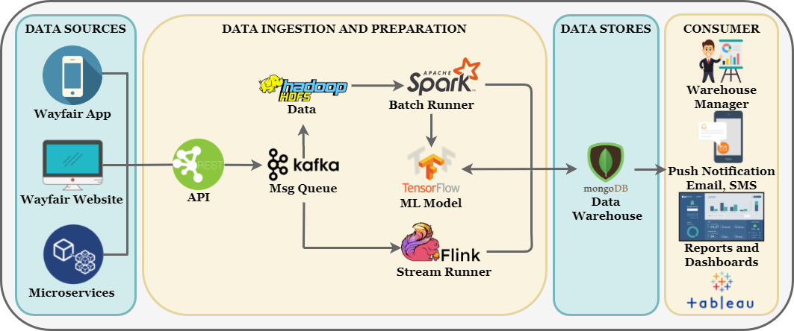
Technical Vision Diagram

Slide 45
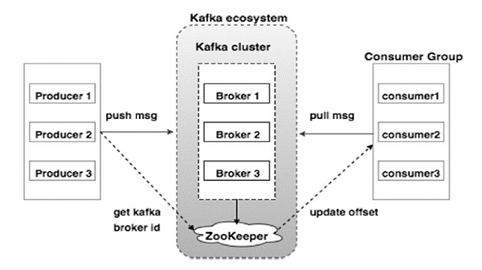
Data Ingestion – Apache Kafka
Apache Kafka is a distributed data system. It is optimized for ingesting and processing streaming data in real-time
In this project, we will use Kafka for streaming data to HDFS as well as directly to Apache Flink
It is easy to scale using Apache Kafka and it supports automatic recovery to node failure because of which for most of the data we will be using Apache Kafka as a messaging queue to HDFS and Flink
Kafka runs as a cluster which handles the incoming high volume data streams in the real time. It treats each topic partition as an ordered set of messages. Since in this project, we will need highly reliable and scalable enterprise messaging system to connect multiple systems we will use Apache Kafka for it
Other application areas for Apache Kafka are making data available to multiple subscribers based on their interests, log aggregation services and monitor data from distributed applications

Slide 46
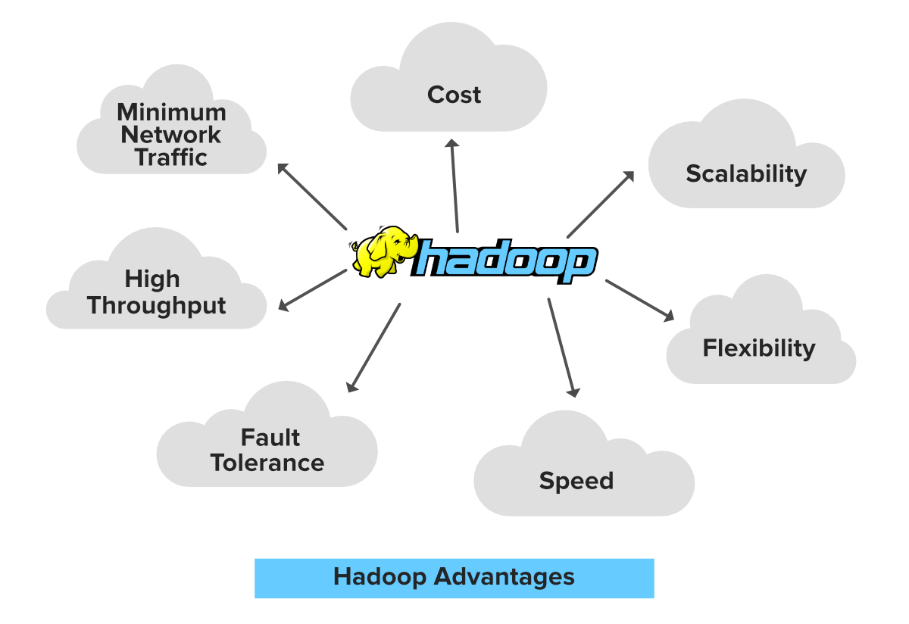
Framework– Apache Hadoop
In this project, we will use Apache Hadoop Framework since it is highly adaptable and offers multiple benefits at single location. From Hadoop Ecosystem, we will use Hadoop Distributed File System (HDFS) for storing the ingested data from Apache Flume and Apache Kafka
We will be running Apache Spark a unified analytics engine for large-scale data processing to read and write data from HDFS. Apache Spark will be used as a standalone by statically allocating resources on all or a subset of machines in a Hadoop cluster and run Spark side by side with Hadoop MR. Then we can then run arbitrary Spark jobs on her HDFS data
When it comes to handling large data sets in a safe and cost-effective manner, Hadoop has the advantage over relational database management systems, and its value for any size business will continue to increase as unstructured data continues to grow in the real time.
It provides a framework that allows distributed processing of large sets of data across clusters of computers using simple programming models.

Slide 47
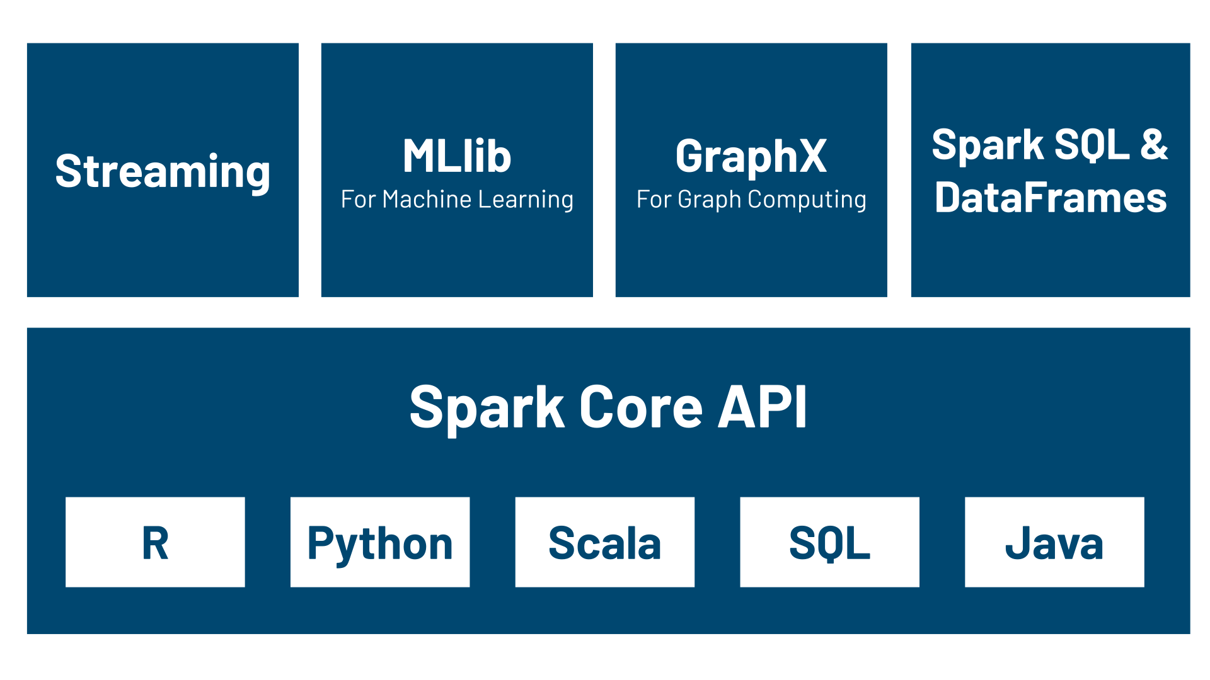
Data Processing – Apache Spark
Apache Spark is a unified analytics engine for big data processing, with built-in modules for streaming, SQL, machine learning and graph processing
Spark offers over 80 high-level operators that make it easy to build parallel apps and is easier to call APIs and use them using Spark
It runs processes 100 times faster than Hadoop, and it fits perfectly in the Hadoop ecosystem
In this project, we will use Apache Spark on Hadoop Framework for data processing and running Machine Learning models using TensorFlow.
We can also analyze the processed data using Spark SQL which is a Spark module for structured data processing.
Another reason for using Apache Spark is it has very large open-source contributors and user base community, which makes it easier for us to write programs and find useful resources.

Slide 48
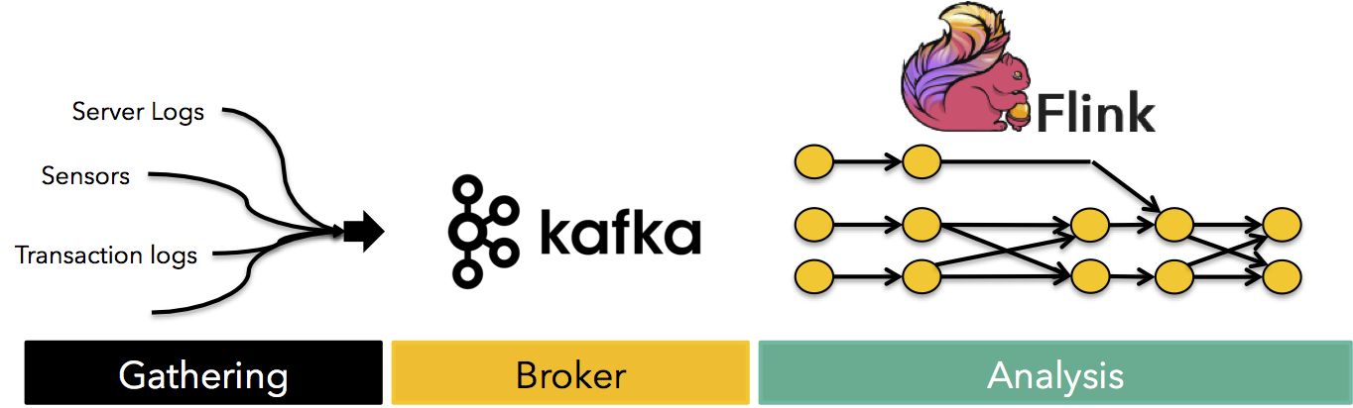
Data Processing – Apache Flink
Apache Flink is an open-source, unified stream-processing and batch-processing framework developed by the Apache Software Foundation.
In this project, we will mainly use Apache Flink for data processing in real-time.
Using Apache Flink, we can have real-time streaming and processing of data since it is faster than Apache Spark and can be used for use cases where very less data computation and processing is needed but low latency is expected.
Good example for such case is, whenever a customer places an order which has many products with multiple quantities, data needs to be computed and processed in real-time to send an email or push notification to the customer.
In such use cases, data needs to be streamed and processed in real-time and Apache Flink will be a best solution to handle it.

Slide 49
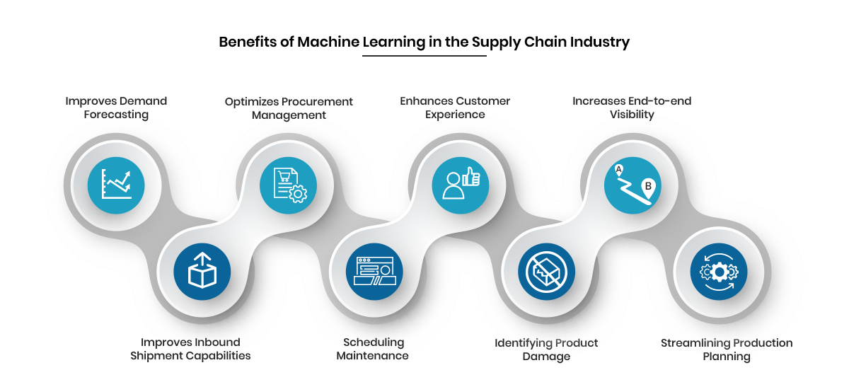
Machine Learning – Managing Logistics
Wayfair being number one retail company for furniture it produces significant amount of data on which we can use AI and ML
With an ever-increasing pace of data creation, Wayfair supply enough data to AI/ML to work to its fullest potential
AI/ML algorithms can provide valuable information such as the number of vehicles available for delivery ahead of time so the customer can know the price and approximate time frames for future deliveries.
Using ML can help automate various cumbersome and time-consuming supply chain processes such as demand forecasting, production planning at Wayfair

Slide 50
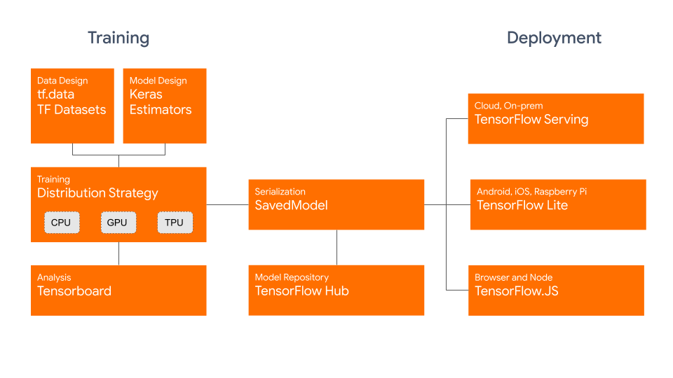
Machine Learning – TensorFlow
In this project, we will use TensorFlow to build models for improving supply chain planning which will help in time, resource and cost-based challenges.
Machine Learning can also be used for Supplier Selection and Supplier Relationship Management
Logistics is heavily reliant on warehouse and inventory-based management and Machine Learning helps in demand forecasting and prevents flaws like understocking and overstocking
With TensorFlow we can easily train and deploy models in the cloud, on-prem, in the browser, or on-device no matter what language you use

Slide 51
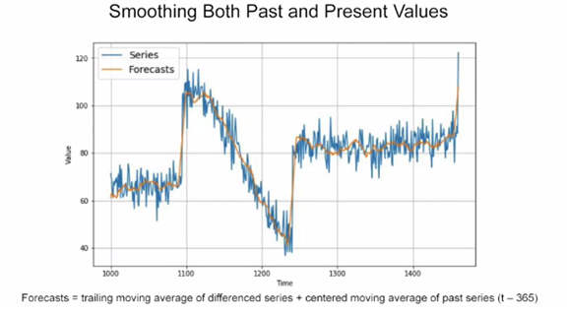
Machine Learning – Demand Forecasting
TIME SERIES APPROACH
This involves processed data points that occur over a specific time that are used to predict the future. Time series is a sequence of data points taken at successive, equally-spaced points in time. The major components to analyze are trends, seasonality, irregularity, cyclicity.
TIME SERIES MODEL
ARIMA (auto-regressive integrated moving average) models aim to describe the auto-correlations in the time series data.
When planning short-term forecasts, ARIMA can make accurate predictions. By providing forecasted values for user-specified periods, it clearly shows results for demand, sales, planning, and production.

Slide 52
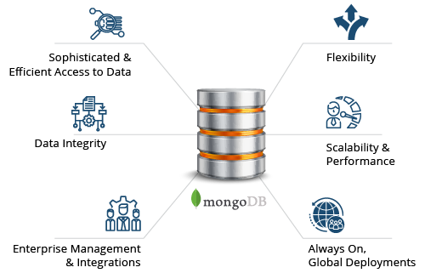
Data Storage – MongoDB
For this project, we will be using MongoDB as database. MongoDB is a source-available cross-platform document-oriented database program. Classified as a NoSQL database program, MongoDB uses JSON-like documents with optional schemas
MongoDB has connectors for both Apache Spark and Apache Flink and works properly on different use cases
In MongoDB, we can search by field, range query and it also supports regular expression searches and indexing for documents. MongoDB provides scalability by Cluster Scale, Performance Scale and Data Scale
Data processed can be in any form, so this needs the database that can handle unstructured data, and which is also highly scalable to store huge amount of data. As powerful as MongoDB is on its own, the integration of Apache Spark extends analytics capabilities even further to perform real-time analytics and machine learning
It supports consistency attribute of Data Governance and provides good security

Slide 53
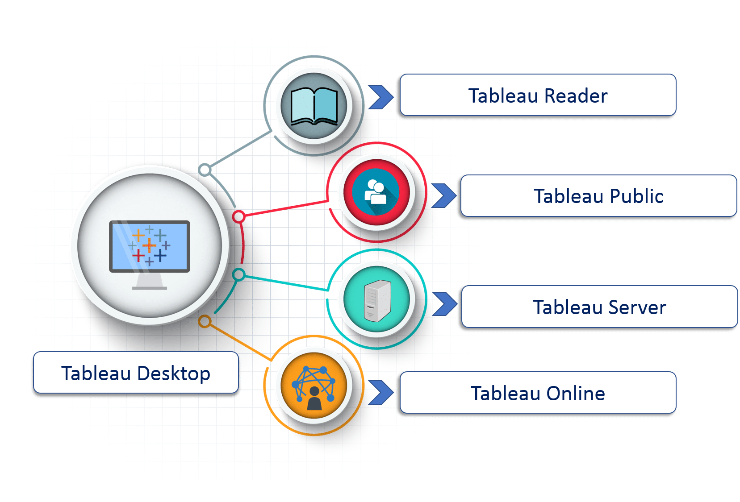
Data Visualization – Tableau
Tableau provide a wholesome view of data by the means of visualizations, visual objects, and text and Tableau Server is highly scalable and provides enterprise-level security
Tableau provides convenient options to collaborate with other users and instantly share data in the form of visualizations, sheets, dashboards, etc. in real-time
In our project, the dashboards and reports will be used by Warehouse Managers, Suppliers and stakeholders to make decisions and understand the different KPIs
Tableau can be connected to MongoDB with the help of MongoDB BI connector and ensures connectivity to both live data sources or data extraction from external data sources in-memory data
Important decisions related to the supply chain management can be made from these dashboard and because of access to live data sources the data will be real-time

Slide 54
Advantages of Hadoop Ecosystem
Scalable - Hadoop is a highly scalable storage platform, because it can store and distribute very large data sets across hundreds of inexpensive servers that operate in parallel
Cost effective - Hadoop offers a cost-effective storage solution for businesses’ exploding data sets.
Fast and Flexible - Hadoop’s unique storage method is based on a distributed file system that basically ‘maps’ data wherever it is located on a cluster which makes it very fast, and it enables to easily access new data sources and tap into different types of data (both structured and unstructured) to generate value from that data
The primary benefit of Hadoop is its Scalability. One can easily scale the cluster by adding more nodes. We can scale vertically as well as horizontally in Hadoop
Vertical scalability
It is also referred as “scale up”. In vertical scaling, you can increase the hardware capacity of the individual machine. In other words, you can add more RAM or CPU to your existing system to make it more robust and powerful
Horizontal scalability
It is also referred as “scale out” is basically the addition of more machines or setting up the cluster. In horizontal scaling instead of increasing hardware capacity of individual machine you add more nodes to existing cluster and most importantly, you can add more machines without stopping the system. Therefore, we don’t have any downtime or green zone, nothing of such sort while scaling out

Slide 55
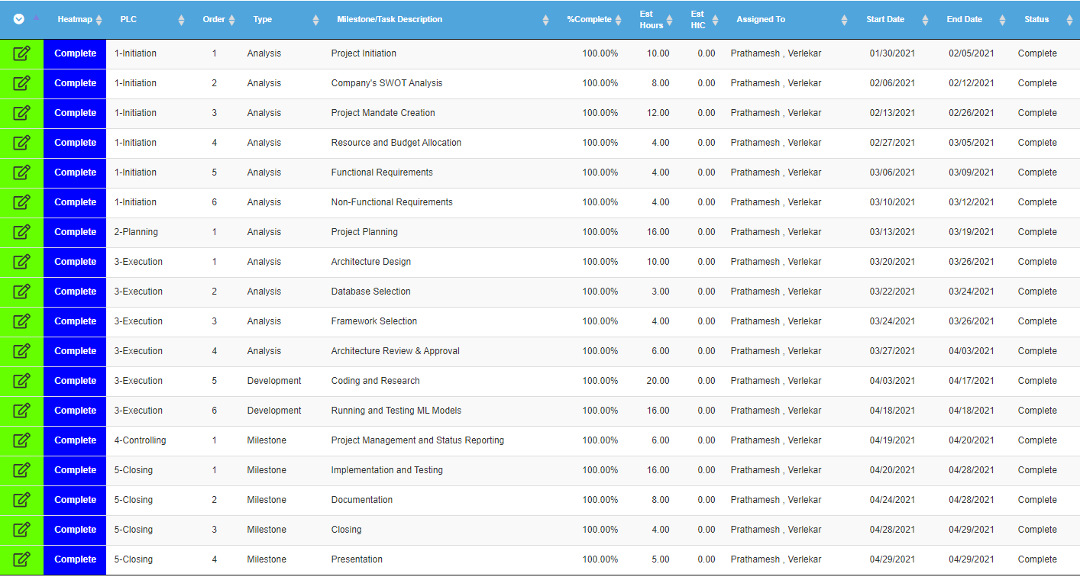
Project Plan

Slide 56
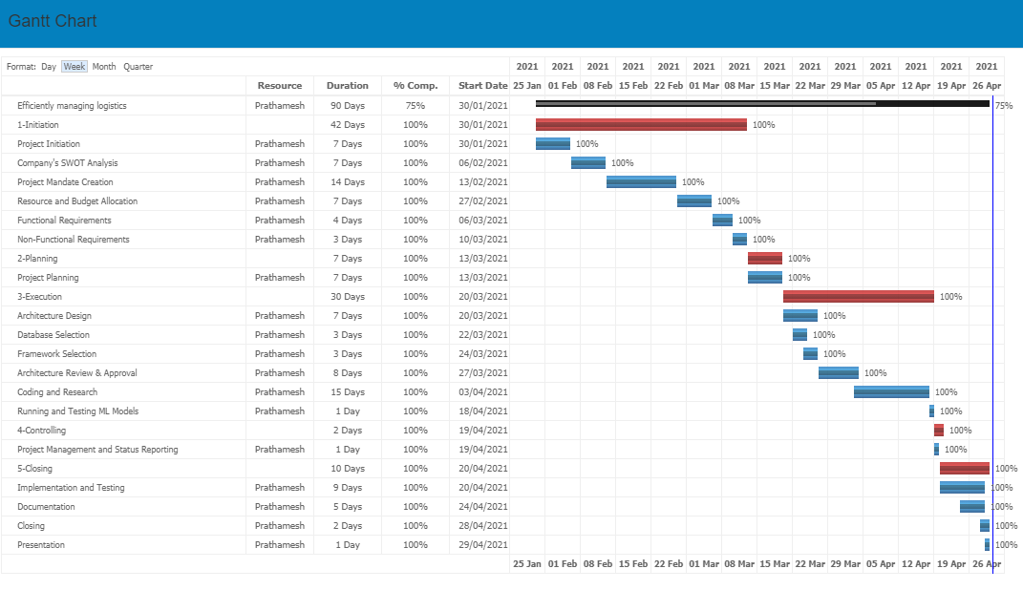
Gantt Chart

Slide 57
Issues and Risks
Issues
Hadoop and ML/AI models are not suited for small data
In initial process, the model execution and prediction will not be accurate and would not show tremendous change in profitability
Hadoop (HDFS) lacks the ability to efficiently support the random reading of small files because of its high-capacity design. Hence there is possibility of data loss containing important insights due to data size which will not get traced by Hadoop and can be a reason to data inconsistency
Risks
Big data systems are challenging for managing complex applications. Anyone who will be working on the system needs to have good understanding of big data platform, if the one working is not experienced the data can be at huge risk
In Hadoop, the security measures are disabled by default. The person responsible for data analytics should be aware of this fact and take the required measures to secure the data, if not done there can be a big risk for the company
Hadoop uses Kerberos authentication, which is a third-party authentication and hard to manage

Slide 58
Data Collection
Data will be collected from Wayfair’s website and mobile application which will be B2C (Business to Customer) data and ingested into Hadoop Distributed File System, HDFS, using Apache Flume and Apache Kafka
Other type of data such as supplier details, quantity remaining of a particular product, location of the supplier, transportation and delivery details which will be B2B (Business to Business) will be collected from different services running in the Wayfair organization and will be stored in HDFS or directly sent to Apache Flink for processing
HDFS is used like a dumping place that holds all the data till it needs to be utilized and that is key with such a large amount of data of customers and all that information about certain category and lifestyle group do not need to be used at all time for analysis
The key thing to remember is it stores data, and we can pull data out of it, but there are no queries involved
Once the data is collected, we can run Spark on top of HDFS for data processing and running ML models
When it comes to handling large data sets in a safe and cost-effective manner, Hadoop has the advantage over relational database management systems, and its value for any size business will continue to increase as unstructured data continues to grow

Slide 59
Data Security
Security in Hadoop requires many of the same approaches seen in the traditional data management system. These include 3 A’s of security
Authentication: It is the first stage that strongly authenticates the user to prove their identities
Authorization: It is the second stage that defines what individual users can do after they have been authenticated
Auditing: Auditing is the process of keeping track of what an authenticated, authorized user did once he gets access to the cluster
For data protection, Hadoop HDFS implements transparent encryption. HFDS has directories called encryption zones. When data is written to Hadoop it is automatically encrypted (with a user-selected algorithm) and assigned to an encryption zone. Encryption is file specific, not zone specific. That means each file within the zone is encrypted with its own unique data encryption key (DEK)
Hadoop is configurable in either secure or non-secure mode. The main difference is that secure mode requires authentication – for every user and service. Kerberos is the basis for authentication in Hadoop secure mode. Data is encrypted as part of the authentication process
Spark also uses a combination of cryptographic splitting and encryption to secure data stored and spilled by Apache Spark, both to the disk as well as to the main memory. Spark approaches provide strong security by incorporating combination of Information from different sources.
Hadoop ecosystem also has a tool for supporting Hadoop Security i.e., Apache Ranger, it is an authorization system that provides or denies access to Hadoop cluster resources such as HDFS files

Slide 60
Data Management
Hadoop YARN is the main component and prerequisite for Enterprise Hadoop, providing resource management and a central platform to deliver consistent operations, security, and data governance tools across Hadoop clusters.
YARN sits between HDFS, and the processing engines being used to run applications. It combines a central resource manager with containers, application coordinators and node-level agents that monitor processing operations in individual cluster nodes.
YARN can dynamically allocate resources to applications as needed, a capability designed to improve resource utilization and application performance. This way Manageability is addressed in YARN- Apache Hadoop
We can also use Apache Ambari for our project which is aimed in making Hadoop management simpler by developing software for provisioning, managing, and monitoring Apache Hadoop clusters.
Ambari enables System Administrators to:
Provision a Hadoop Cluster – It handles configuration of Hadoop services
Manage a Hadoop Cluster – It provides central management for starting, stopping, and reconfiguring Hadoop services
Monitor a Hadoop Cluster – It provides a dashboard for monitoring health and status of the Hadoop cluster.

Slide 61
Data Management Key Aspects
There are few important things that are key for the success and needs to be managed properly for this project
Data will be combined from multiple data sources, and we need to Implement Data Governance best practices using Apache Atlas or Data3Sixty
Data Access - Increasing access to data while handling Data Security
Analytic Prioritization - what set of data needs to be looked at first and what can be looked at later
Multi-tenancy - YARN allows multiple access engines (either open-source or proprietary) to use Hadoop as the common standard for batch, interactive and real-time engines that can simultaneously access the same data set
Cluster utilization - YARN’s dynamic allocation of cluster resources improves utilization over more static MapReduce rules used in early versions of Hadoop
Scalability - Data center processing power continues to rapidly expand. YARN’s Resource Manager focuses exclusively on scheduling and keeps pace as clusters expand to thousands of nodes managing petabytes of data

Slide 62
Data Governance
Data governance (DG) is the process of managing the availability, usability, integrity and security of the data in enterprise systems, based on internal data standards and policies that also control data usage
Data Availability - Data availability is about the timeliness and reliability of access to and use of data. It includes data accessibility. For our project, the website files must remain accessible to prevent site downtime and disruption of service
Data Usability - The data in an organization can be used to meet the goals defined in the corporate strategy, including data monetization. To help make project’s analytics applications more effective, we need to augment conventional data quality processes with measures aimed at improving data usability for analysts
Data Security - For our project, securing the customer and supplier data is imperative, so it is important to protect it and it should only be available to be viewed by the specific group of users
Data Integrity – Data integrity is the accuracy, completeness, and reliability of data throughout its lifecycle. So, after examining these important factors of data governance, we will have a good idea of the capabilities of the data collected and being processed
Data increasingly drives enterprise decision-making, but it must undergo a variety of changes and processes to go from raw form to formats more practical for identifying relationships and facilitating informed decisions. Therefore, data integrity is a top priority for our project

Slide 63
Data Governance Goals and Benefits
The key goal of data governance is to break down data silos in an organization. A data silo is a repository of fixed data that remains under control of one department and is isolated from others. Data governance aims to harmonize the data in those systems through a collaborative process, with stakeholders from the various business units participating
Another data governance goal is to ensure that data is used properly, both to avoid introducing data errors into systems and to block potential misuse of personal data about customers and other sensitive information
The benefits that data governance strategies provides in the project include improved data quality; lower data management costs; and increased access to needed data for data scientists, other analysts and business users
Data Quality – It can be defined as the degree to which a set of characteristics of data fulfills requirements. Examples of characteristics are completeness, validity, accuracy, consistency, availability and timeliness
People involved in the data governance process will be,
Chief data officer
Data governance manager and team
Data governance committee
Data stewards (Business and Technical Data Steward)

Slide 64
THANK YOU

